Slide 1
Stephanie Sabshin, DVM Harmony Vet Care, Tampa, FL

Slide 2
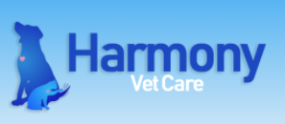
Table Side Service with in House Lab
Improved patient care with appropriate treatment provided at time of service
Allows staff to focus on today’s patients and not tie up a tech handling yesterday’s test results
Pre-Imagyst, we would have 1 tech devoted to call backs: now it’s 1-2 hours a day; efficiency leads to $ savings
Before integrating in house labs, we would have 50-60 call backs a day

Slide 3
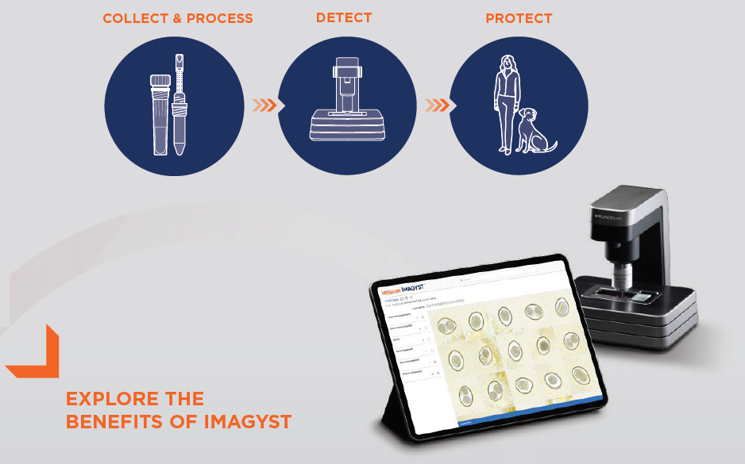
Set it and Forget it!
By collecting samples at the beginning of your appt:
Allows you to finish your exam
Administer vaccines
Put in your charges
Type up your notes
Finish with appropriate treatment based on sample results
***Harmony Vet Care has 10 min appts

Slide 4
Health of the Practice
Prior to Imagyst, we sent 410 fecals to reference lab resulting in (4 mo period):
More call back time
Less deworming
Less prevention education at time of service
After Imagyst, we doubled our volume without even trying. Still sent samples to lab but also ran 436 in house test (4 months)
Effected practice’s bottom line:
Prevents chewy scripts
Gained $9500 in fecal related revenue in 4 mo ($2400/mo)

Slide 5
Health of the Patient
Effected patient care:
Increased deworming 20% by having instant results
Had preventative conversation with client and sent home with preventative
Fill dewormer script in house as opposed to client receiving treatment plan next day and requesting a Chewy script

Slide 6
“I am pleasantly surprised this data shows across the board increase in floats and dewormers, without any attempt on the part of the clinic to reach these numbers. We simply brought this fecal analyzer on, and did our normal thing.” ----Stephanie Sabshin, DVM

Slide 7
How To Implement
DVM informed staff they were switching to in house fecals
Reception tells owners to bring a sample with them
All staff received a quick 15 min training session
Zoetis team offers continued support and technical training
It was THAT easy

